Slide 1
Data Science SQL Mini-Project Presentation on Structured Query Language (SQL) Topic- cars24 (second hand car dealer) PRESENTED BY:- VALMIK A.SATAV(cds05_008)

Slide 2

OUTLINE
Introduction
dataset overview
methodology
insights
conclusion
future work

Slide 3
INTRODUCTION
I am presenting a project on the topic ‘cars24 car dealer’ in this project I have tried to give all information about project in an activity that help us to improve company manager to improve his planning and thinking ability
We have choose this topic because company mangaer is easy to handling all cars details.which is how many cars are available in year wise, how many cars sold in year,type of fuel cars ,anything about cars
I have divided this presentation in methodology,insights which is use in this project and conclusion

Slide 4

Dataset Overview
In this project we use dataset cars24 which is second hand car dealer this dataset appers to focus imfomation like dealing with cars sales or services
The dataset comprises certain number of columns
Columns:-
Cars Name:-specified model of the car
Year:-Manufacturing year of the car
Selling_Price:-cost of the car
Km_driven:-km car has run
Fuel:-fuel used in the car
SellerType
Transmission:-automatic or manual car
Owner-First owner,second owner
Mileage:-Represent a total distance car has travelled
Engine:-It define cc
Seats-how many seats in car

Slide 5
Methodology
Data Extraction :-In this project, we extract sql queries to retrieve and manipulate data from the relational database.
SELECT-It is used to select coumn and rows
WHERE-It used the filter the rows
JOIN –We use it combine the data from multiple columns
Aggerigation function-max,min,count,avg and sum in the column
Tools:-There are various tools and utilities available to work with sql databases
MySQL Workbench: A visual tool for MySQL database design, development, and administration.
Microsoft SQL Server Management Studio (SSMS): For managing sql Server databases.
Oracle SQL Developer: A graphical tool for Oracle database development.
pgAdmin: A comprehensive PostgreSQL management tool.
Explanation of SELECT statement
WHERE clause

Slide 6
Insights
1. -- Read cars data
In this query all dataset are shown
Syntax-
SELECT * FROM cars24;
2. -- counting the total number cars present in the data set
this query used to the count the total rows in the dataset
Syntax-
select count(*) from cars24
3. --The manager asked the employee how many cars will be available in 2023?
It seems like the manager is inquiring about the number of cars that will be available in the year 2023.
Syntax-
SELECT COUNT(*) FROM cars24
WHERE Year =2020;
filtering the rows we can use where statement.

Slide 7
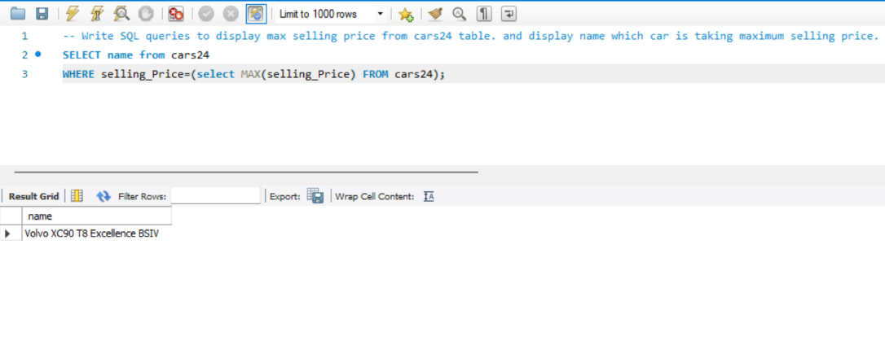
Insights
4. -- Write SQL queries to display max selling price from cars24 table. and display name which car is taking maximum selling price.
In this query we use sub_query to get output
syntax-
SELECT name from cars24
WHERE selling_Price=(select MAX(selling_Price) FROM cars24);

Slide 8
Insights
5. -- Write SQL queries to display second highest selling price from cars24 table. and display name which car is taking second highest selling price.
- the manager asked the employer which car is second highest selling price and get their name
-we can solve this question by using sub_query
Syntax-
SELECT name from cars24
WHERE selling_Price=(select MAX(selling_Price) FROM cars24
WHERE selling_price !=(select MAX(selling_Price) FROM cars24));
-In this query use aggregate function max to find highest selling price.
Using subqueries in SELECT, WHERE, and FROM clauses

Slide 9
Insights
6. clint requested to car dealer agent how many petrol cars will there be in 2020?
-we can use count function to get rows
-where use in filtering the rows
Syantax-
SELECT COUNT(*) FROM cars24
WHERE Year=2020 and fuel='petrol';
.

Slide 10
Insights
7. The manager told the employee to give a print the fuel cars CNG come by all year.
-The manager asked the employer print the cng cars from all year sell
Syntax-
SELECT Year,COUNT(*) FROM cars24
WHERE fuel='CNG'
GROUP BY Year;
- In this query use Group by it collect the data from multiple rows and groups the result by one or more columns.

Slide 11
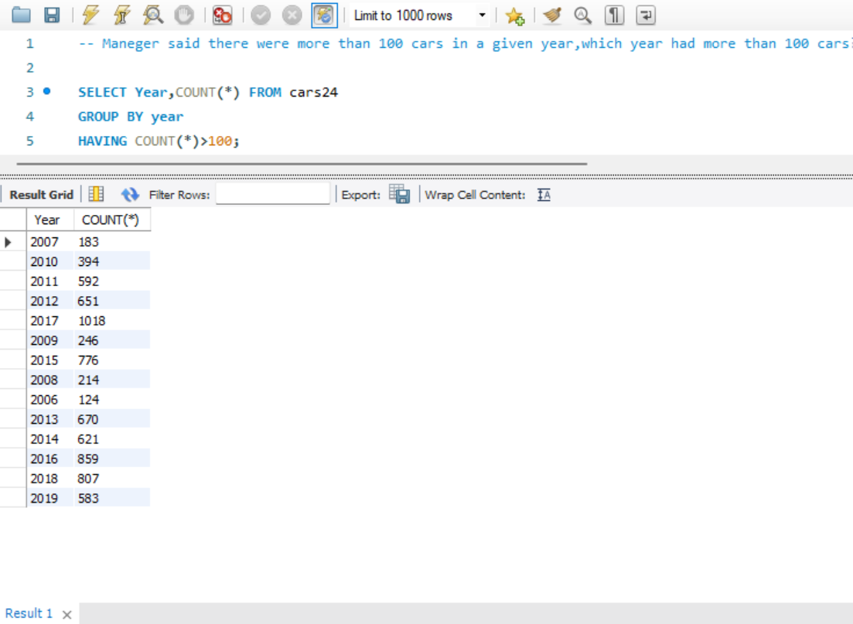
Insights
8. Maneger said there were more than 100 cars in a given year,which year had more than 100 cars?
-Syntax-
SELECT Year,COUNT(*) FROM cars24
GROUP BY year
HAVING COUNT(*)>100;
- use having function it is similar to where i.e applies some condition
on rows.used when we want to apply any condition after grouping

Slide 12
Insights
9. The manager said to the employee all cars count details between 2015 and 2020; we need a complete list.
Syntax-
SELECT COUNT(*) FROM cars24
WHERE Year between 2015 and 2020;
-use between certain range.
10. The manager said to the employee all cars details between 2015 to 2023 we need complete list.
Syntax-
SELECT * FROM cars24
WHERE Year BETWEEN 2015 AND 2023;

Slide 13
Conclusion
In this psentation we covered basics of sql.including its syntax and statement functions and aggregation. Sql is powerful tool for managing relational database.
By understanding sql,you can effectively retrieve and manipulate the data .
this topic helps to company mangaer is easy to handling all cars details.which is how many cars are available in year wise, how many cars sold in year,type of fuel cars ,anything about cars.

Slide 14
future work
Sales Analytics:Generate a report on the total number of cars sold, total revenue, and average transaction amount for each month in the last year.
Popular Car Brands:Identify the top 5 most popular car brands based on the total number of cars sold.
Inventory Management:Find the number of cars available for sale by each seller.

